Slide 1
Between the years 2008 and 2010, Endometrial cancer received 2.9 million dollars less from the NIH to fund cancer research

Slide 2
Is there Enough Funding aimed at endometrial cancer Research?
Gabriela Rodriguez

Slide 3
Looking at Endometrial Cancer…
Commonly known as Uterine cancer
Received the least amount of funding from the NIH in 2010
Who does it affect?
Symptoms
Notes:
NIH main goal: research, studying the causes, prevention, detection, diagnosis, and treatment-> divides up funding based on whats necessary to make most rapid progress against cancer as possible
Most common cancer of the female reproductive system
Mostly postmenopausal women, 25% before menopause
abnormal bleeding, unusual vaginal discharge, weight loss, and pelvic pain/pressure

Slide 4
Looking at Breast Cancer…
Can affect both men and women
Most “popular”
Will affect 12% of women in the US
Effect one women
Notes:
Not only in the number it affects but also most advertised
1 in every 8
Effects women not just physically but emotionally and physiologically

Slide 5
Endometrial Cancer vs. Breast Cancer…
Endometrial
Very few treatment options
  No standardized treatment plan
Positive outlooks
  84% across all stages
Breast
Survival rate at Stage 1 is 98%
Mammograms and Self Breast Exams
Second highest cause of death by cancer in women
“Womenhood”
Notes:
Endometrial-hysterectomy(removal of their uterus), and removal of both their ovaries and fallopian tubes; there are common practices;

Slide 6
Because I researched cancer research funding, I decided to make a video presentation of my interview with an Oncologist for my product in order to learn more about cancer research funding.
Notes:
Explain how you still thought there had to be a better way

Slide 7
Refreshing my memory…
Looking over research done previously
Finding additional research
Coming up with the interview questions
Notes:
Looked at old notes
Looked for more general information

Slide 8
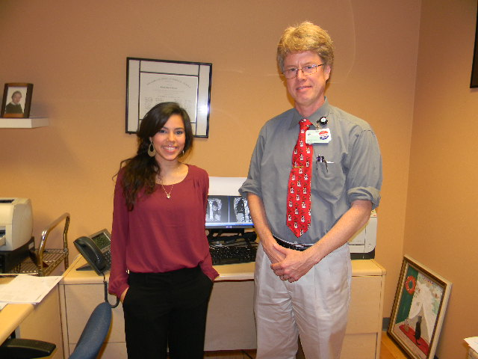
Making the video…
Filming the introduction
Interviewing Dr. Russell Anderson
Editing
Notes:
Filmed myself-> what I talked about
Give examples of the questions you asked
The editing process

Slide 9
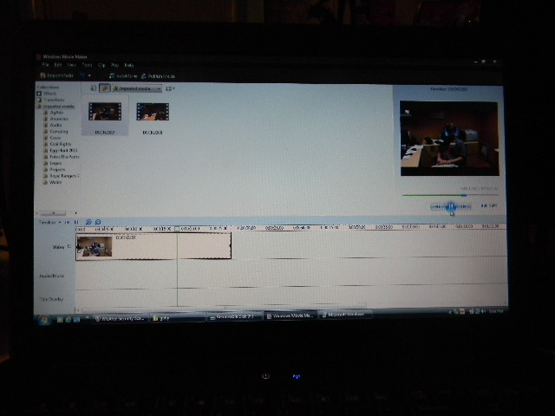
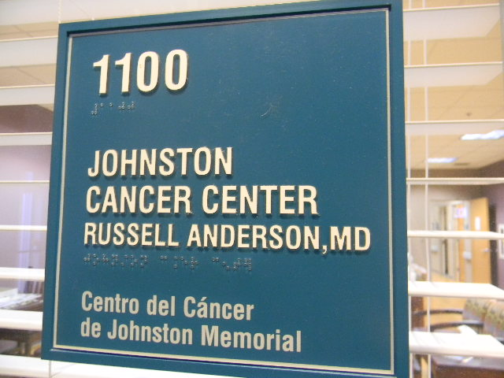
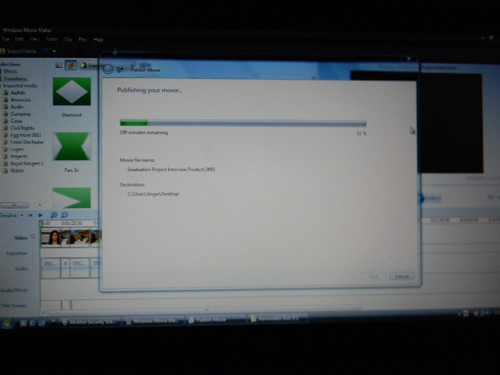
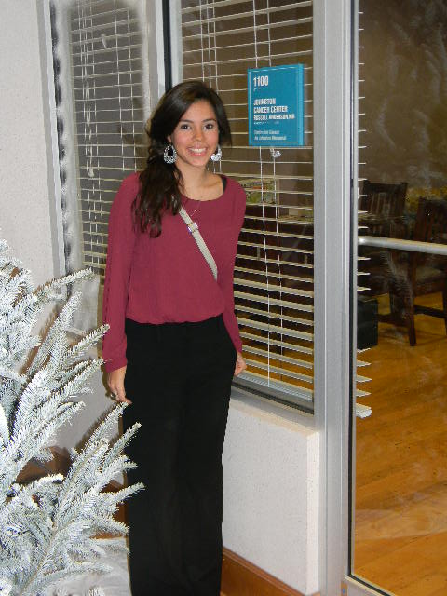


Slide 10
Sharing what I learned…
Showing the video to the HOSA club at CHS
A change in perspective…

Slide 11
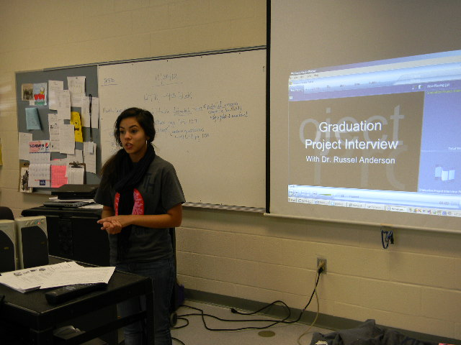
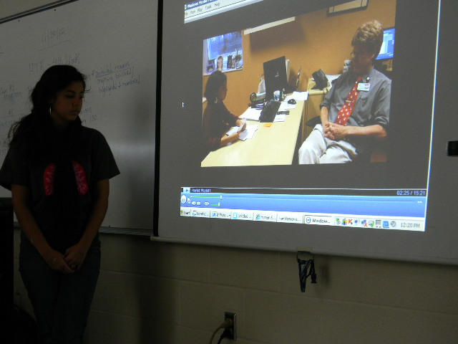
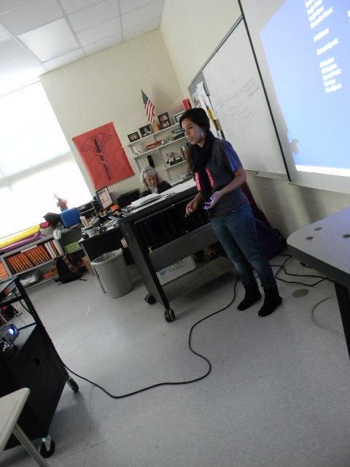


Slide 12
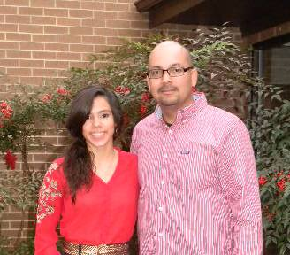
Elias Sanchez
Elias Sanchez is works for G&E building airplane engines and also has his own Photography business.
The interview was an on camera interview, Elias shared his knowledge of photography and was always ready to put in his thoughts and any advice.

Slide 13
Challenges and Successes
Challenges
  Finding a mentor
  Relying too much on a single interviewee
  Working with movie maker
Successes
  Used movie maker successfully
  The interview itself

Slide 14
What I Learned
A different way to look at cancer research funding
Using Windows Movie Maker
Public speaking skills

Slide 15
Thank you for your time.
Do you have any questions?

